Slide 1
Anomaly detection in large graphs - powerful tools and the intuition behind them.
Christos Faloutsos
CMU & Amazon (sabbatical)

Slide 2
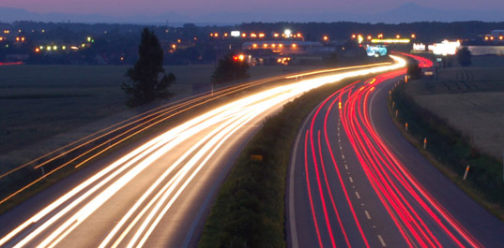
Roadmap
Motivation
Why study graphs for amazon?
Part#1: Static graphs - unsupervised
Part#2: Static graphs – semi-supervised
Part#3: time-evolving graphs; tensors
Conclusions

Slide 3



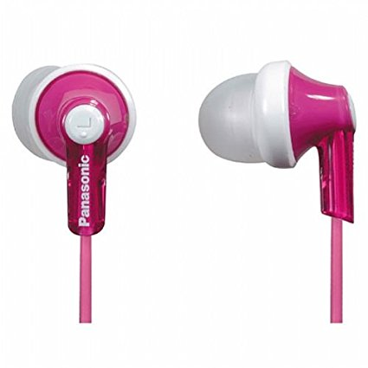


Graphs
Recommendation systems
....
…
…

Slide 4
P1: static graphs - unsupervised
Anything suspicious?
…
…

Slide 5
P1: static graphs - unsupervised
Anything suspicious now?
128.2.2.3
…
128.5.5.5
…

Slide 6


P2: static graphs – semi-supervised
Anything suspicious now?
128.2.2.3
…
…

Slide 7
P3: Time-evolving
Anything suspicious?
3am, 4/1
128.2.2.3
…
3am, 4/1
…
10pm, 4/3

Slide 8
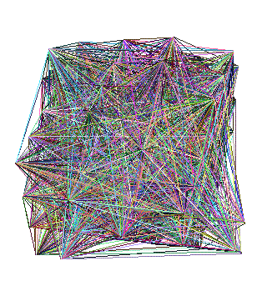
Part 1:
Static, un-sup

Slide 9
Roadmap
Motivation
Part#1: Static graphs – unsupervised
P1.1: Patterns
P1.2: Tools
Part#2: Static graphs – semi-supervised
Part#3: time-evolving graphs; tensors
Conclusions

Slide 10
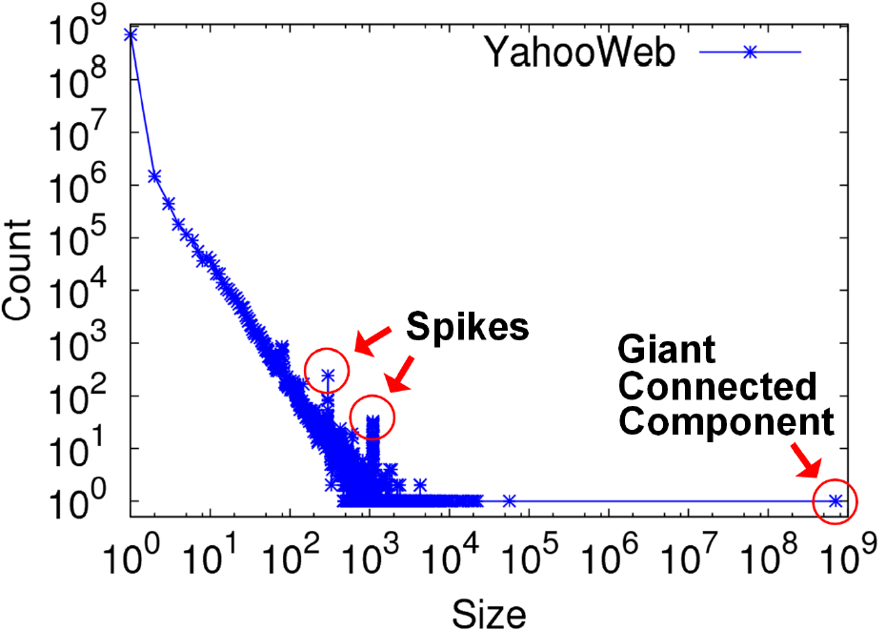

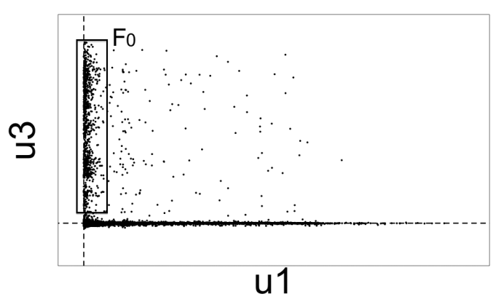
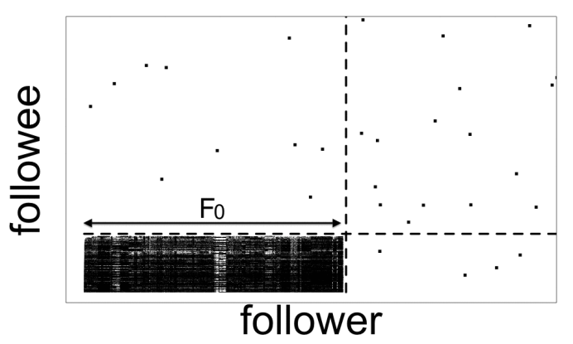
P1: static – unsup: Recipes
R1.1) Power law
violations
128.2.2.3
R1.2) eigenPlots

Slide 11
Patterns <-> Anomalies
Cloud of random points, right?

Slide 12

Patterns <-> Anomalies
Cloud of random points, right?
… until we notice the line-up:
Patterns anomalies
Let’s look for patterns, in static graphs

Slide 13
Laws and patterns
Q: Are real graphs random?

Slide 14
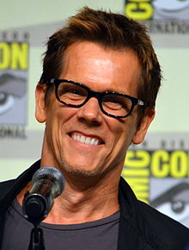
Laws and patterns
Q: Are real graphs random?
A: NO!!
Diameter (‘6 degrees’; ‘Kevin Bacon’)
in- and out- degree distributions
other (surprising) patterns
So, let’s look at the data

Slide 15
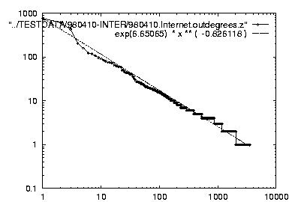
Solution# S.1
Power law in the degree distribution [Faloutsos x 3 SIGCOMM99]
internet domains
att.com
log(degree)
ibm.com
log(rank)

Slide 16
Solution# S.1
Power law in the degree distribution [Faloutsos x 3 SIGCOMM99]
internet domains
att.com
log(degree)
ibm.com
-0.82
log(rank)

Slide 17
Foiled by a power law

Slide 18

S2: connected component sizes
Connected Components – 4 observations:
Count
1.4B nodes
6B edges
Size

Slide 19
S2: connected component sizes
Connected Components
Count
1) 10K x
larger
than next
Size

Slide 20
S2: connected component sizes
Connected Components
Count
2) ~0.7B
singleton
nodes
Size

Slide 21
S2: connected component sizes
Connected Components
Count
3) SLOPE!
Size

Slide 22
S2: connected component sizes
Connected Components
Count
300-size cmpt
X 500.
Why?
1100-size cmpt
X 65.
Why?
4) Spikes!
Size

Slide 23
S2: connected component sizes
Connected Components
Count
suspicious
financial-advice sites
(not existing now)
Size

Slide 24
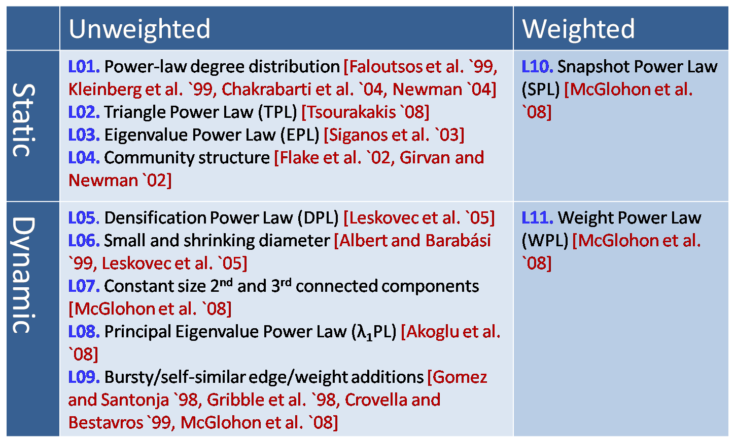
MORE Graph Patterns
✔
✔
RTG: A Recursive Realistic Graph Generator using Random Typing Leman Akoglu and Christos Faloutsos. PKDD’09.

Slide 25
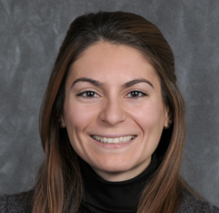
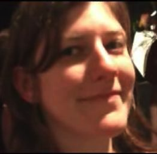
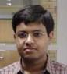

MORE Graph Patterns
Mary McGlohon, Leman Akoglu, Christos Faloutsos. Statistical Properties of Social Networks. in "Social Network Data Analytics” (Ed.: Charu Aggarwal)
Deepayan Chakrabarti and Christos Faloutsos, Graph Mining: Laws, Tools, and Case Studies Oct. 2012, Morgan Claypool.

Slide 26
Roadmap
Motivation
Part#1: Static graphs – unsupervised
P1.1: patterns
P1.2: tools - spectral
Part#2: Static graphs – semi-supervised
Part#3: time-evolving graphs; tensors
Conclusions

Slide 27

How to find ‘suspicious’ groups?
‘blocks’ are normal, right?
idols
fans

Slide 28
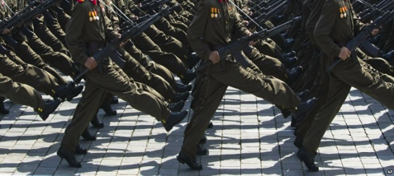
Except that:
‘blocks’ are normal, right?
‘hyperbolic’ communities are more realistic [Araujo+, PKDD’14]

Slide 29
Except that:
‘blocks’ are usually suspicious
‘hyperbolic’ communities are more realistic [Araujo+, PKDD’14]
Q: Can we spot blocks, easily?

Slide 30
Except that:
‘blocks’ are usually suspicious
‘hyperbolic’ communities are more realistic [Araujo+, PKDD’14]
Q: Can we spot blocks, easily?
A: Silver bullet: SVD!

Slide 31
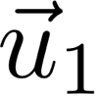
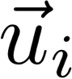
Crush intro to SVD
Recall: (SVD) matrix factorization: finds blocks
‘music lovers’
‘singers’
‘sports lovers’
‘athletes’
‘citizens’
‘politicians’
M
idols
N
fans
+
+
~

Slide 32
Crush intro to SVD
Recall: (SVD) matrix factorization: finds blocks
‘music lovers’
‘singers’
‘sports lovers’
‘athletes’
‘citizens’
‘politicians’
M
idols
N
fans
+
+
~

Slide 33
Crush intro to SVD
Recall: (SVD) matrix factorization: finds blocks
Even if shuffled!
‘music lovers’
‘singers’
‘sports lovers’
‘athletes’
‘citizens’
‘politicians’
M
idols
N
fans
+
+
~

Slide 34
SVD - intuition
✅
Hidden/latent variable detection
Block detection
Dimensionality reduction
embedding

Slide 35
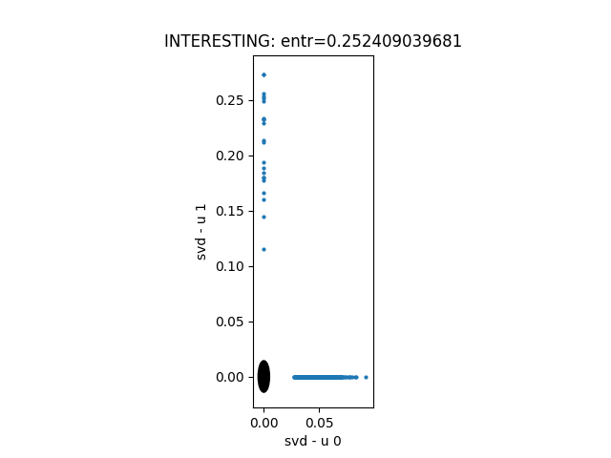
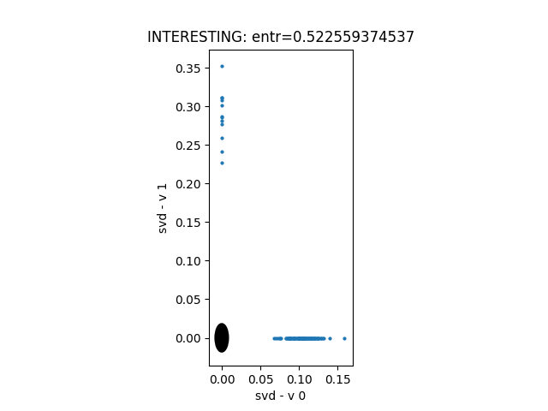
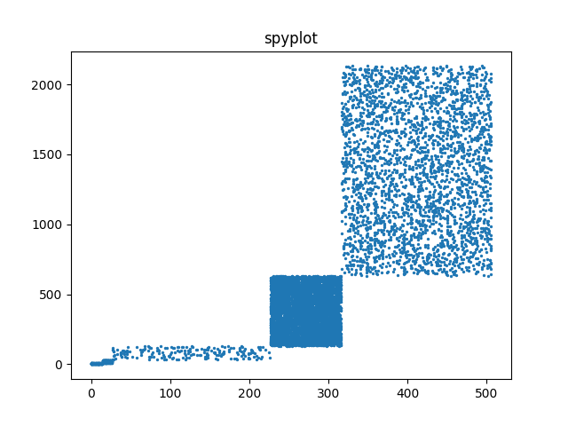
Toy example – 5 blocks
v₀
v₁
‘customers’
u₀
u₁
u₁
v₁
‘IP-addresses’
u₀
v₀
EigenPlots

Slide 36
Toy example – 5 blocks
v₀
v₁
‘customers’
u₀
u₁
u₁
v₁
‘IP-addresses’
u₀
v₀

Slide 37
SVD - intuition
✅
Hidden/latent variable detection
Block detection
Dimensionality reduction
embedding
✅

Slide 38
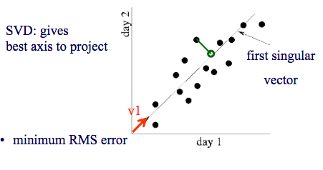
SVD - intuition
#128.1.1.3
#logins from 128.1.1.1

Slide 39
SVD - intuition
‘customers’
u₁
500-d vector
‘Smith’
2-d
‘Smith’
‘IP-addresses’
u₀

Slide 40
SVD - intuition
✅
Hidden/latent variable detection
Block detection
Dimensionality reduction
Embedding (linear)
SVD is a special case of ’deep neural net’
✅
✅
✅

Slide 41
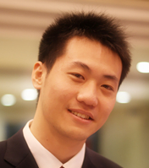
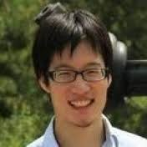
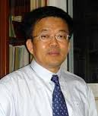

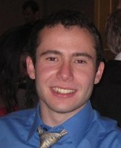
Inferring Strange Behavior from Connectivity Pattern in Social Networks PAKDD’14
OPTIONAL
Meng Jiang, Peng Cui, Shiqiang Yang (Tsinghua)
Alex Beutel, Christos Faloutsos (CMU)

Slide 42
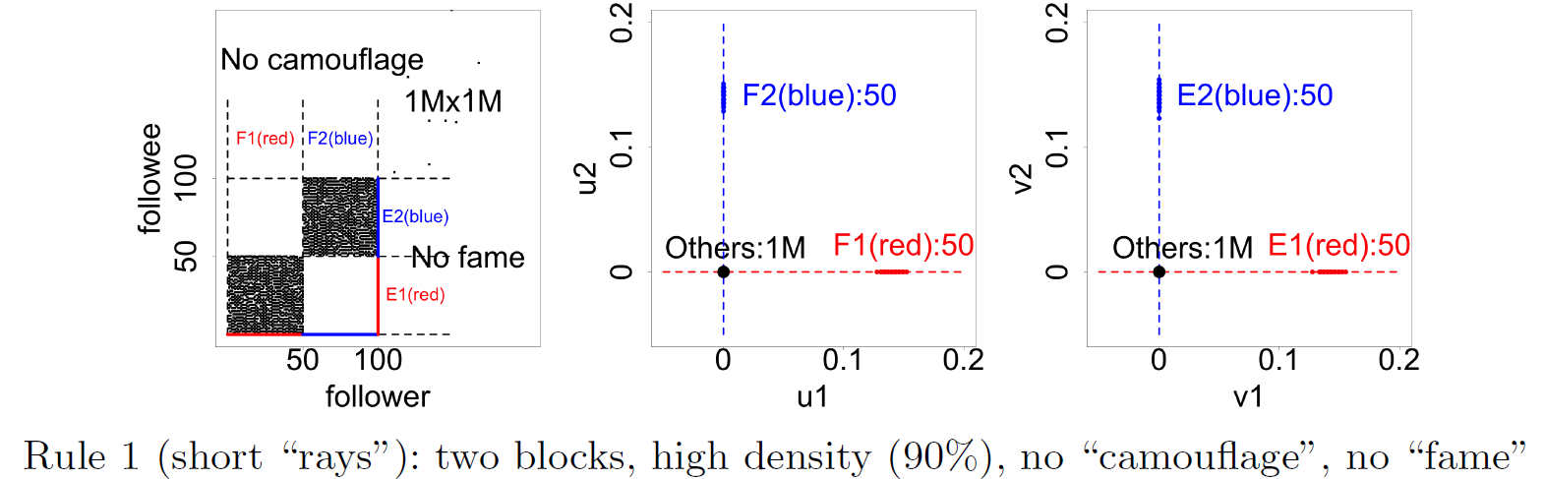
Lockstep and Spectral Subspace Plot
OPTIONAL
Case #1: non-overlapping lockstep
“Blocks” “Rays”
Adjacency Matrix
Spectral Subspace Plot

Slide 43
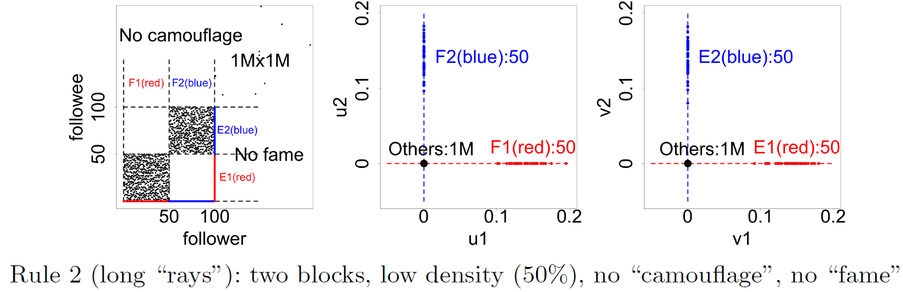
Lockstep and Spectral Subspace Plot
OPTIONAL
Case #2: non-overlapping lockstep
“Blocks; low density” Elongation
Adjacency Matrix
Spectral Subspace Plot

Slide 44
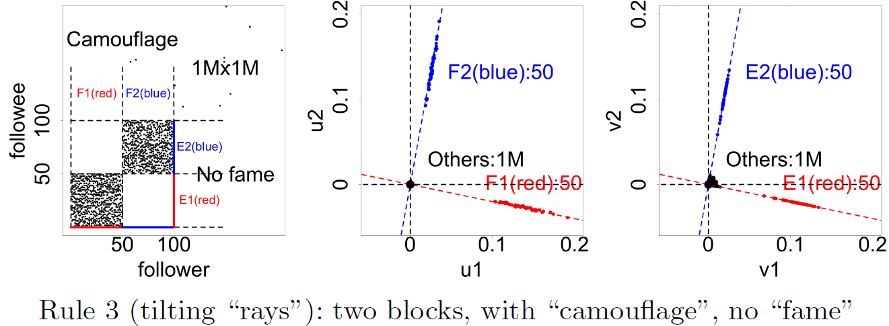
Lockstep and Spectral Subspace Plot
OPTIONAL
Case #3: non-overlapping lockstep
“Camouflage” (or “Fame”) Tilting “Rays”
Adjacency Matrix
Spectral Subspace Plot

Slide 45
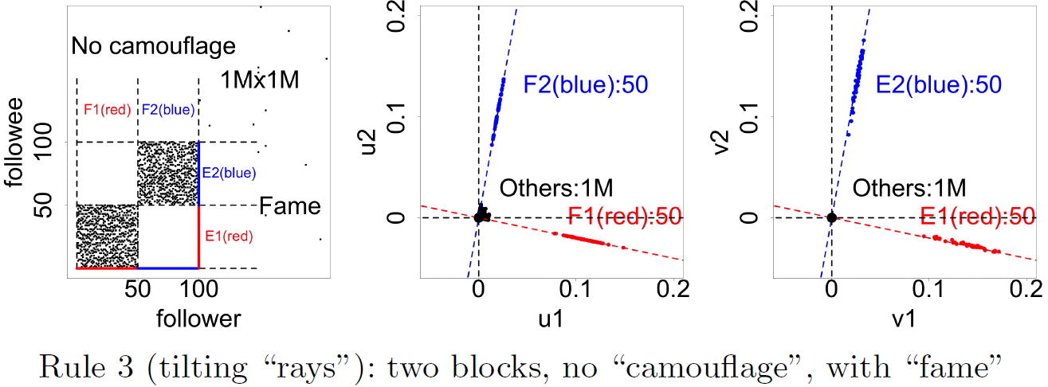
Lockstep and Spectral Subspace Plot
OPTIONAL
Case #3: non-overlapping lockstep
“Camouflage” (or “Fame”) Tilting “Rays”
Adjacency Matrix
Spectral Subspace Plot

Slide 46
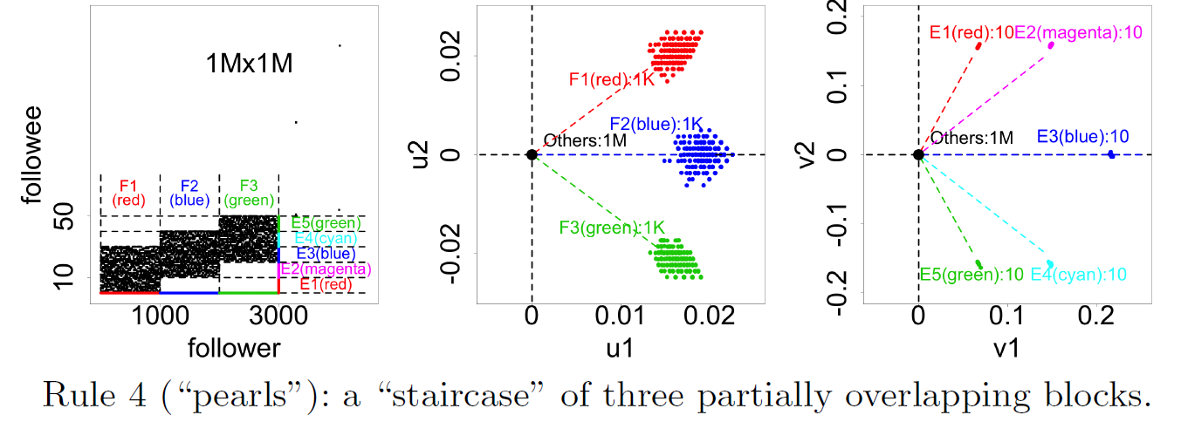
Lockstep and Spectral Subspace Plot
OPTIONAL
Case #4: ? lockstep
“?” “Pearls”
Adjacency Matrix
Spectral Subspace Plot
?

Slide 47
Lockstep and Spectral Subspace Plot
OPTIONAL
Case #4: overlapping lockstep
“Staircase” “Pearls”
Adjacency Matrix
Spectral Subspace Plot

Slide 48

Dataset
OPTIONAL
Tencent Weibo
117 million nodes (with profile and UGC data)
3.33 billion directed edges

Slide 49
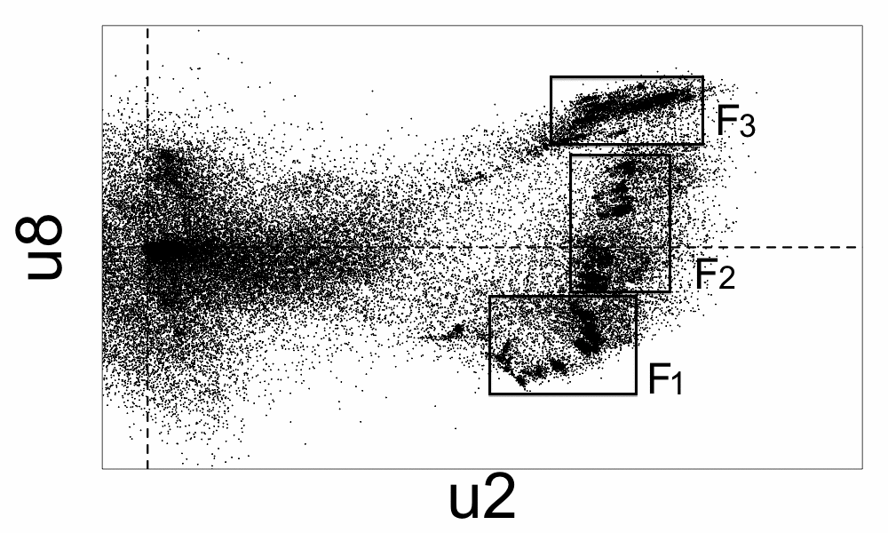
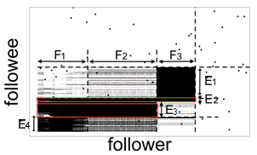
Real Data
OPTIONAL
“Rays”
“Block”
“Pearls”
“Staircase”

Slide 50
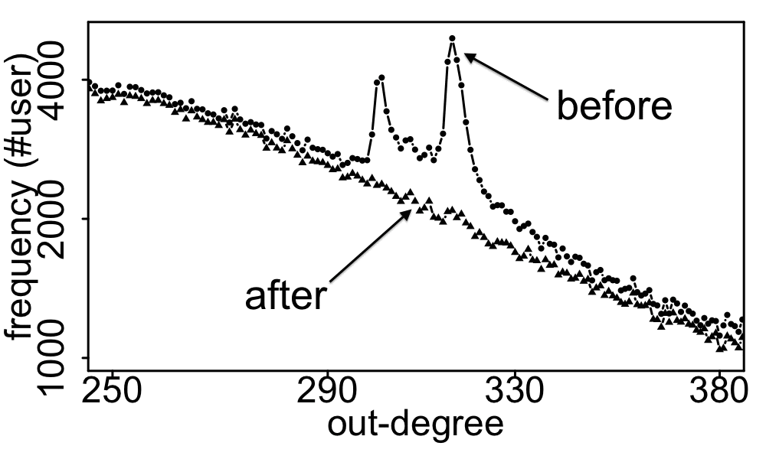
Real Data
OPTIONAL
Spikes on the out-degree distribution
×
×

Slide 51
P1: static – unsup: Recipes
R1.1) Power law
violations
128.2.2.3
R1.2) eigenPlots

Slide 52
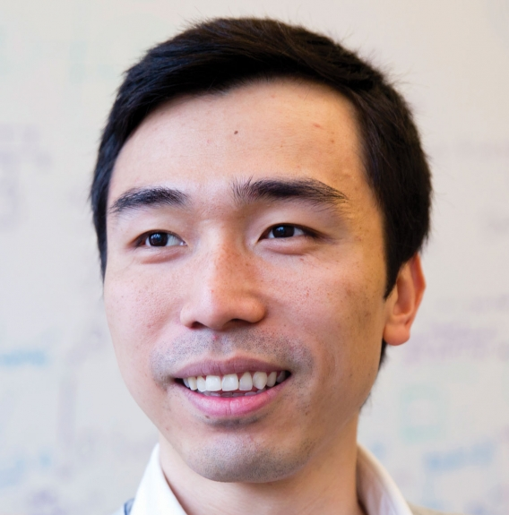
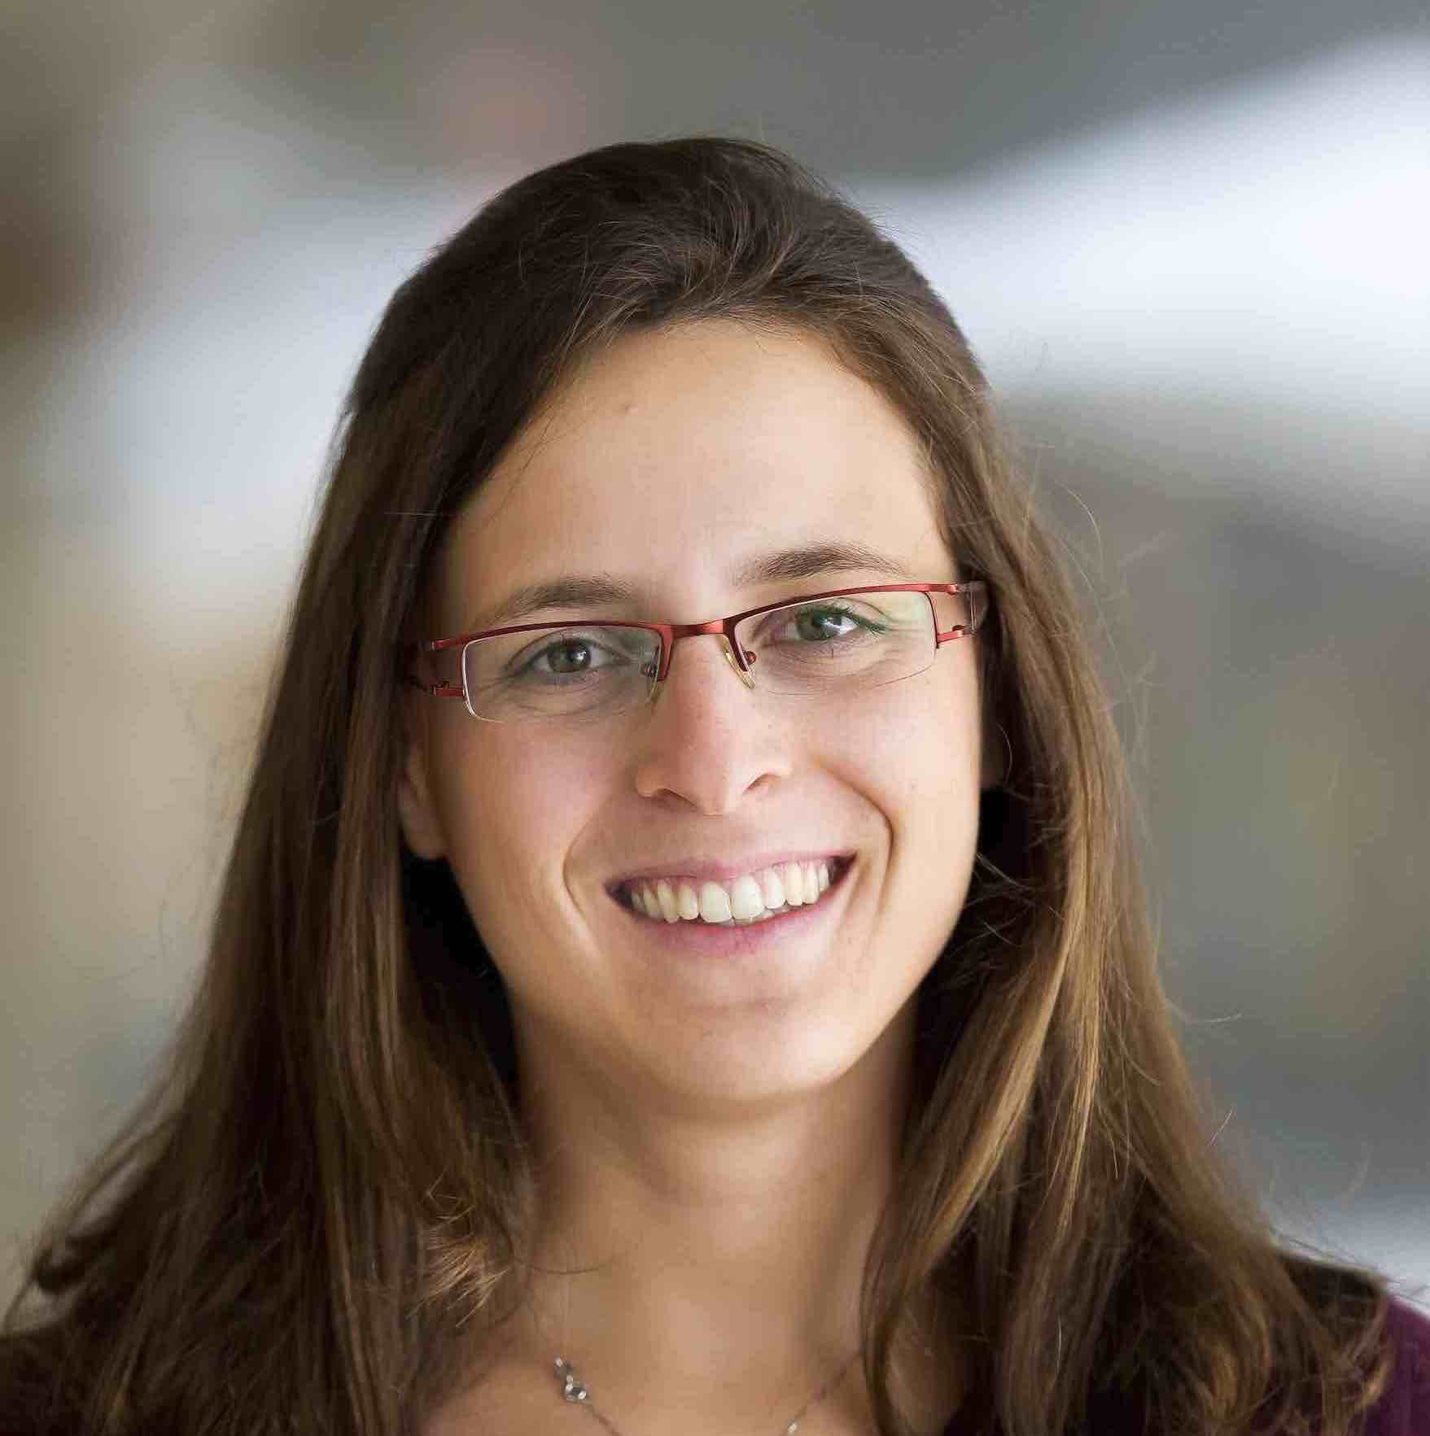
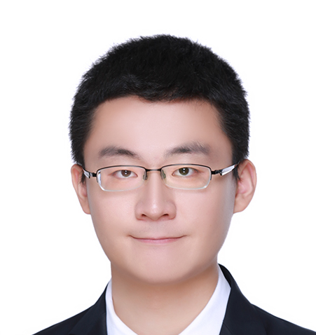
Should we do that from scratch?
Not necessarily: Visualization & ‘attention routing’ packages
Polo Chau +:
http://fredhohman.com/papers/playground
Danai Koutra + : PERSEUS-HUB
http://perseushub.com
http://perseushub.com/datasets/27
Di Jin

Slide 53
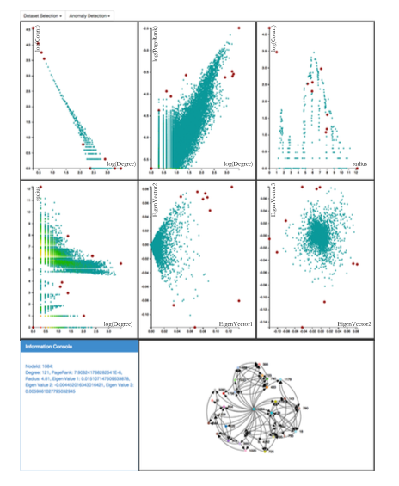
PERSEUS

Slide 54
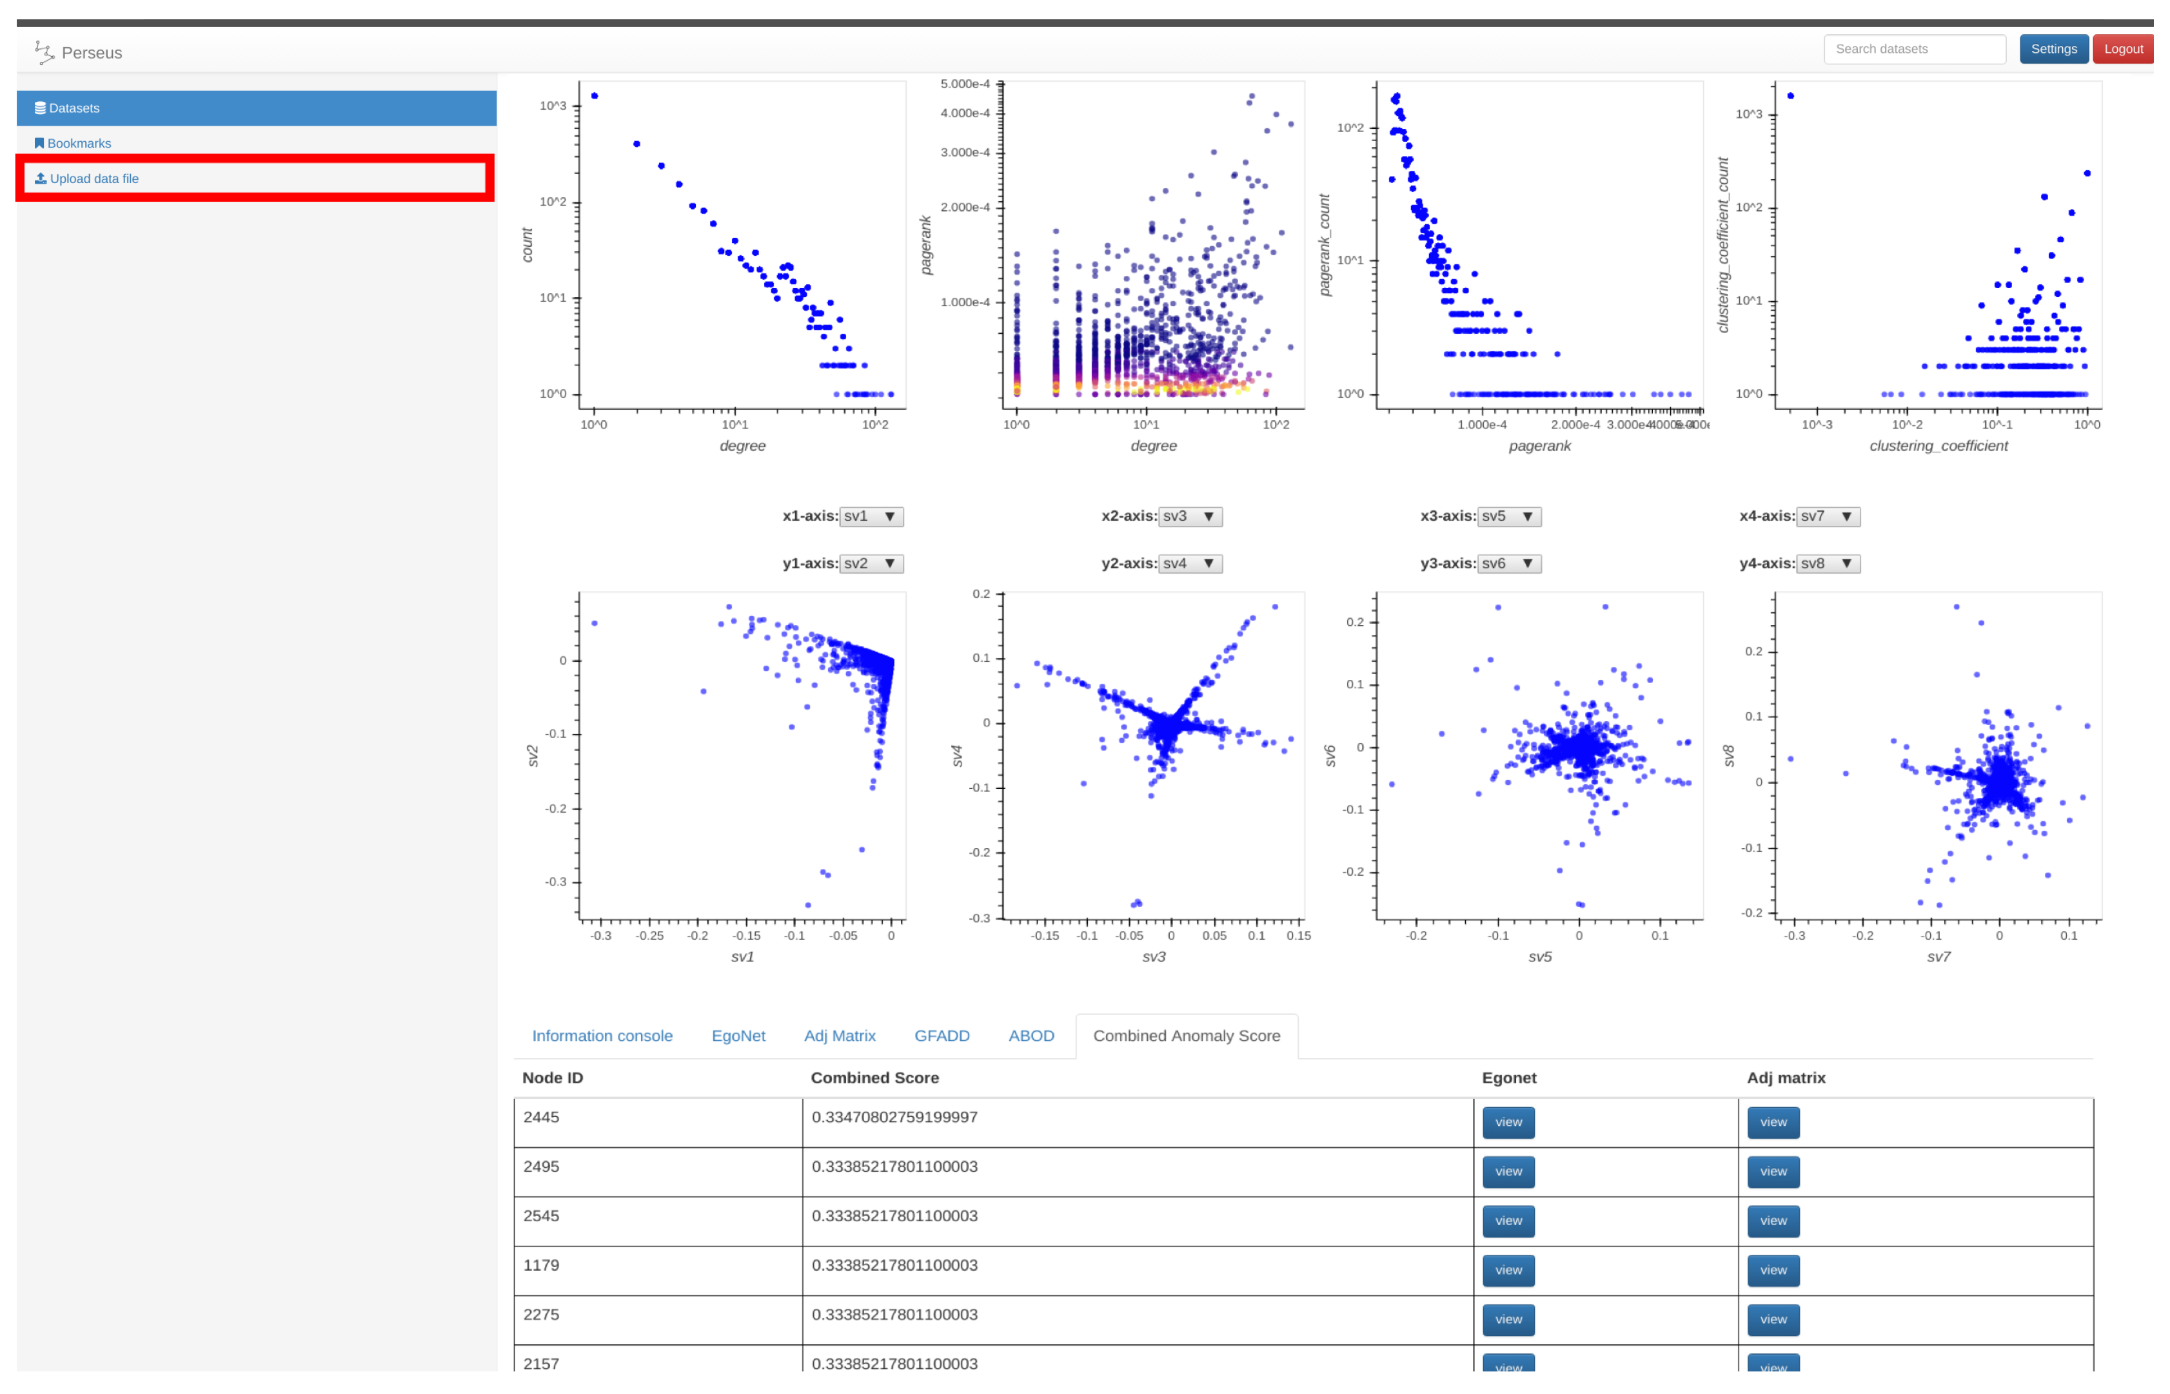
PERSEUS-HUB
http://perseushub.com
http://www.mdpi.com/2227-9709/4/3/22/pdf
Jin +, PERSEUS-HUB: Interactive and Collective Exploration of Large-Scale Graphs, Informatics 2017

Slide 55
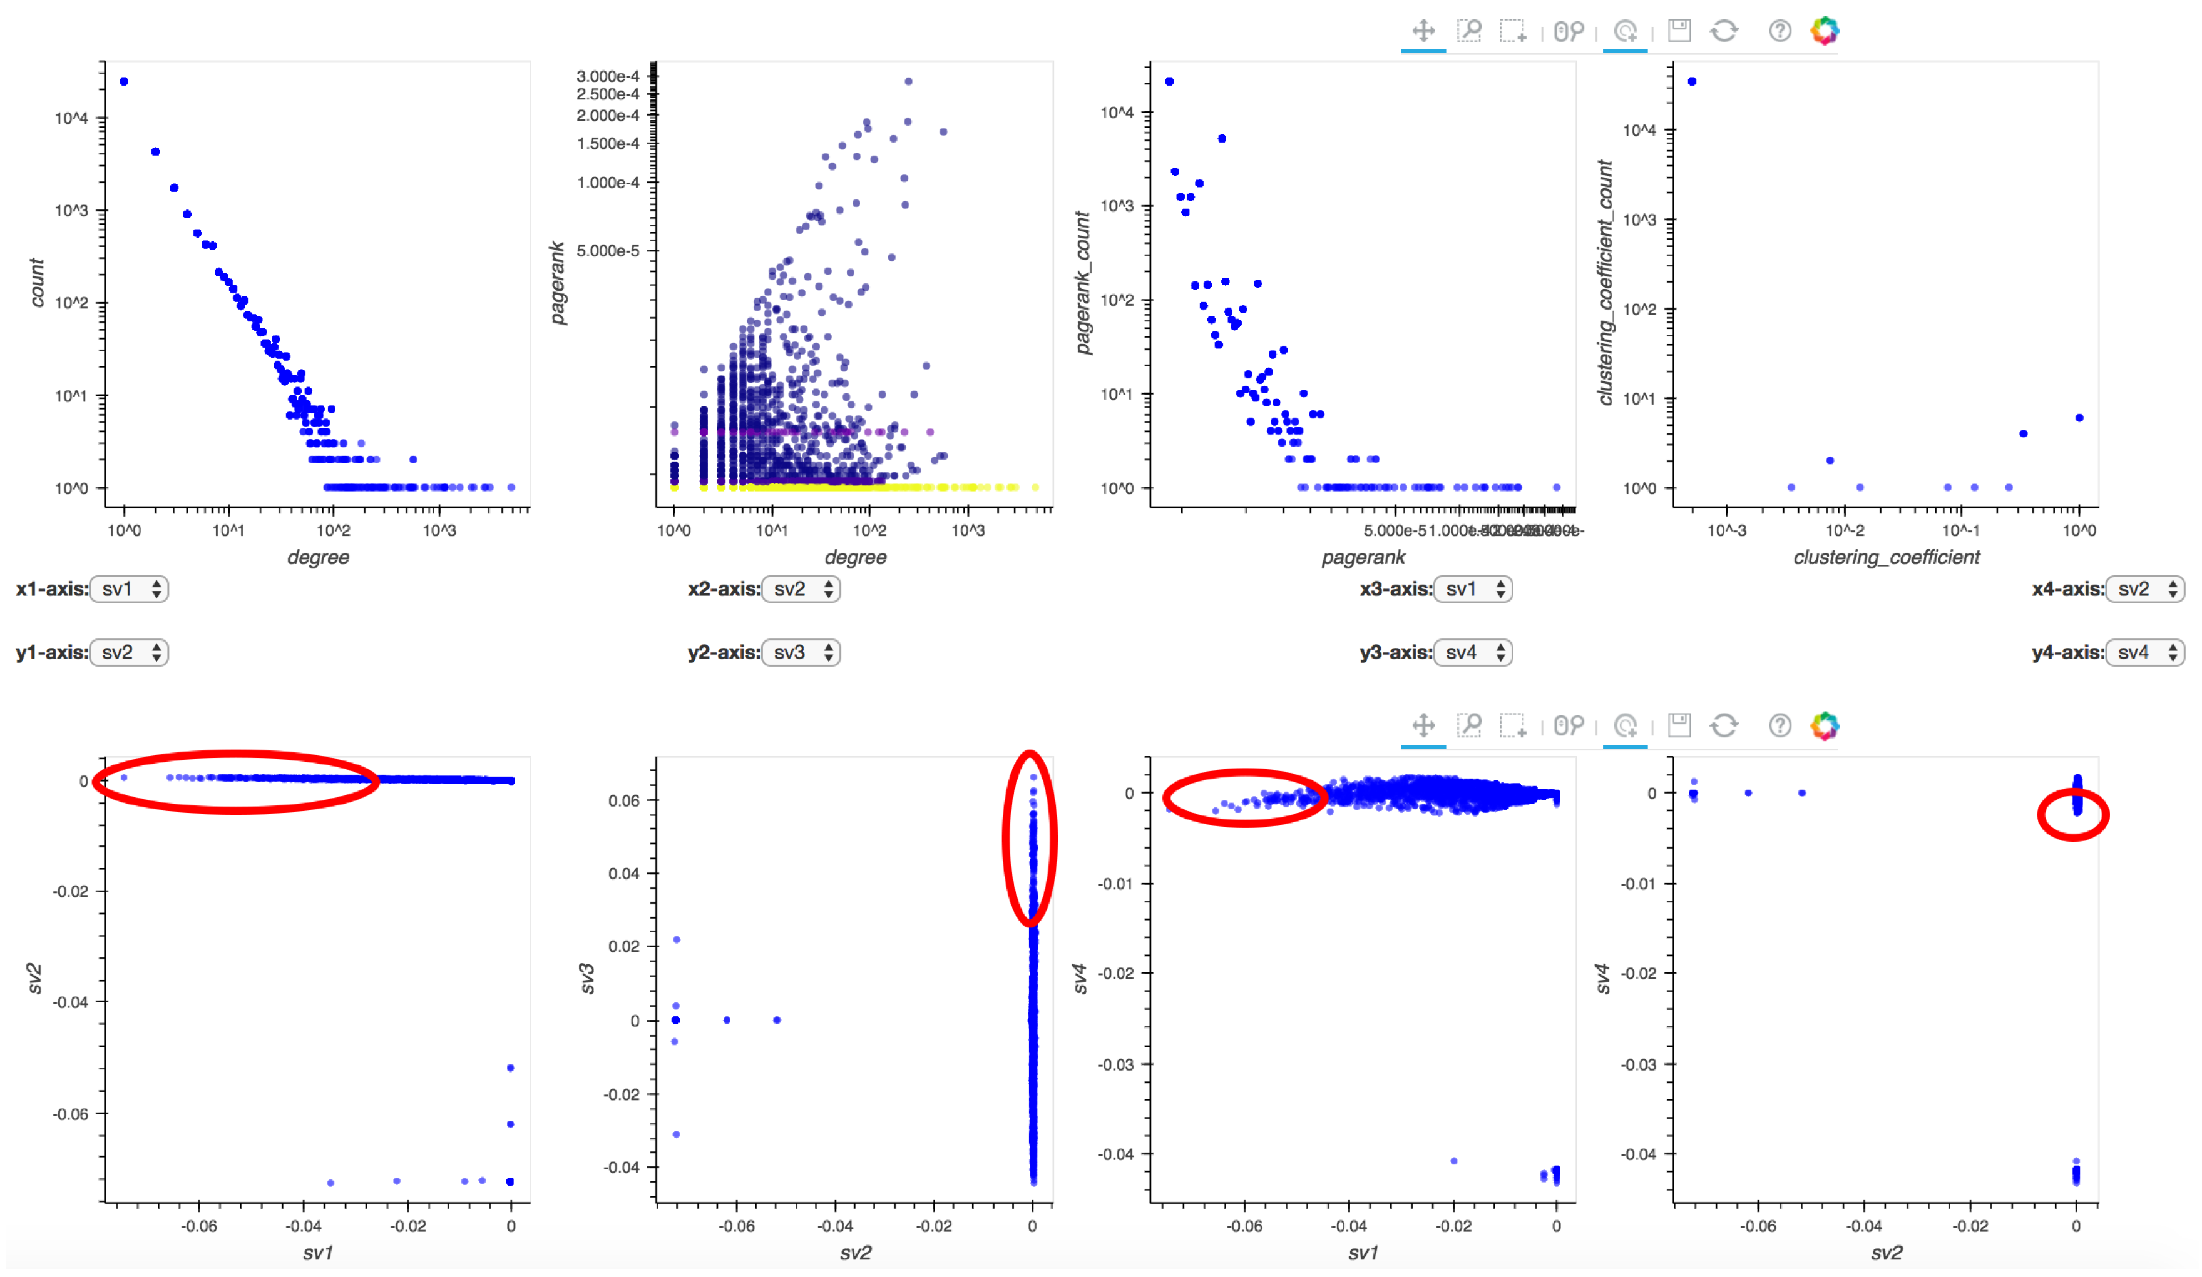
PERSEUS-HUB
http://www.mdpi.com/2227-9709/4/3/22/htm
Jin +, PERSEUS-HUB: Interactive and Collective Exploration of Large-Scale Graphs, Informatics 2017

Slide 56
Roadmap
Motivation
Why study graphs for amazon?
Part#1: Static graphs - unsupervised
Part#2: Static graphs – semi-supervised
Motivation: e-bay fraud [Chau+]
BP: Basics
Linearized BP [Koutra +]
Applications
…

Slide 57
Part 2:
Static graphs;
Semi-sup

Slide 58
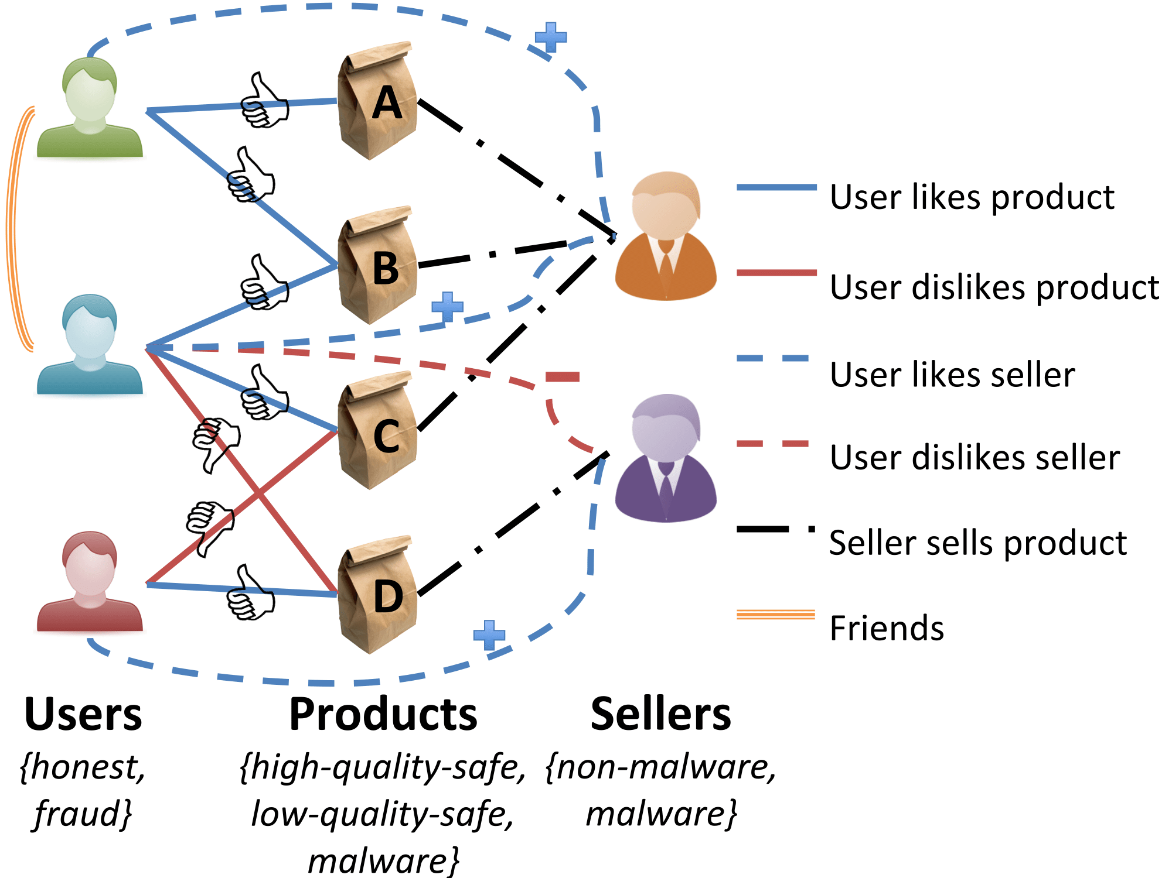
P2: static – semi-sup: Recipes
R2: BP, and zooBP
www.cs.cmu.edu/~deswaran/code/zoobp.zip
128.2.2.3

Slide 59
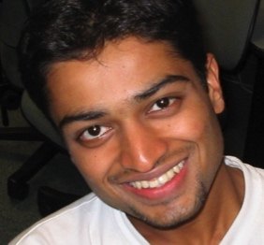
E-bay Fraud detection
OPTIONAL
w/ Polo Chau &
Shashank Pandit, CMU
[PKDD’06][WWW’07]
Detecting Fraudulent Personalities in Networks of Online Auctioneers. Duen Horng (Polo) Chau, Shashank Pandit, and Christos Faloutsos. (PKDD) 2006

Slide 60
E-bay Fraud detection
OPTIONAL

Slide 61
E-bay Fraud detection
OPTIONAL

Slide 62
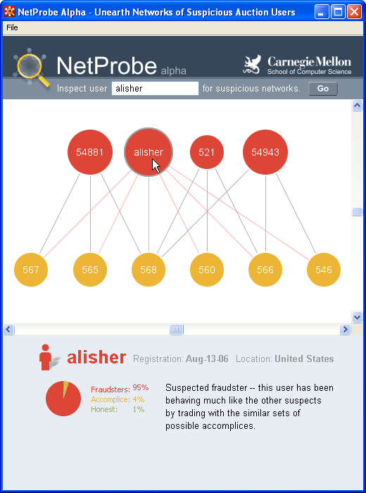
E-bay Fraud detection - NetProbe
OPTIONAL

Slide 63
Roadmap
Motivation
Why study graphs for amazon?
Part#1: Static graphs - unsupervised
Part#2: Static graphs – semi-supervised
Motivation: e-bay fraud [Chau+]
BP: Basics
Linearized BP [Koutra +]
Applications
…

Slide 64
Background
Danai Koutra
U. Michigan

Slide 65

Belief Propagation
“Propagation matrix”:
Homophily
Iterative message-based method
AI
class of receiver
class of
sender
0.9 | 0.1
0.2 | 0.8
...
until stop criterion fulfilled
1st round
Heterophily
2nd round
Usually same diagonal = homophily factor h
0.9 | 0.1
0.1 | 0.9
0.3 | 0.7
0.9 | 0.1
PL
[Pearl ‘82][Yedidia+ ’02] … [Gonzalez+ ‘09][Chechetka+ ‘10]
Notes:
Class of receiver / class of sender : without bubbles

Slide 66
Belief Propagation Equations
message(i −> j) ≈ belief(i) • homophily strength
0.9 | 0.1
0.2 | 0.8
…
…
i
j
Notes:
Equations of original BP: “Notice non-linearity” + grey background + citations →na xwrisw sta 2 + zwgrafia sto xarti (prior belief san tou ukang, + mhnymata geitonwn
NOTATION for messages etc - this is non-linear

Slide 67
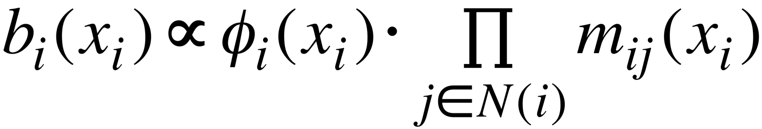
Belief Propagation Equations
belief of i
prior
belief
messages from neighbors
…
i
j
Notes:
Equations of original BP: “Notice non-linearity” + grey background + citations →na xwrisw sta 2 + zwgrafia sto xarti (prior belief san tou ukang, + mhnymata geitonwn
NOTATION for messages etc - this is non-linear

Slide 68
Background

Slide 69
Roadmap
Motivation
Why study graphs for amazon?
Part#1: Static graphs - unsupervised
Part#2: Static graphs – semi-supervised
Motivation: e-bay fraud [Chau+]
BP: Basics
Linearized BP [Koutra +]
Applications
…

Slide 70
Unifying Guilt-by-Association Approaches: Theorems and Fast Algorithms
Danai Koutra
U Kang
Hsing-Kuo Kenneth Pao
Tai-You Ke
Duen Horng (Polo) Chau
Christos Faloutsos
ECML PKDD, 5-9 September 2011, Athens, Greece
Notes:
Work in collaboration with National Taiwan University

Slide 71
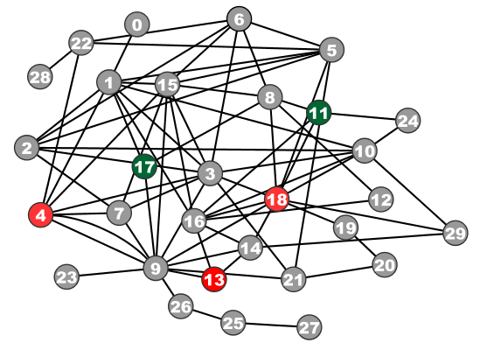
Problem Definition: GBA techniques
?
Given: Graph; &
few labeled nodes
Find: labels of rest
(assuming network effects)
?
?
?
Notes:
Classification problem where we assume that neighboring nodes are related
Network effects – birds of a feather flock together

Slide 72

Are they related?
RWR (Random Walk with Restarts)
google’s pageRank (‘if my friends are important, I’m important, too’)
SSL (Semi-supervised learning)
minimize the differences among neighbors
BP (Belief propagation)
send messages to neighbors, on what you believe about them

Slide 73
Are they related?
YES!
RWR (Random Walk with Restarts)
google’s pageRank (‘if my friends are important, I’m important, too’)
SSL (Semi-supervised learning)
minimize the differences among neighbors
BP (Belief propagation)
send messages to neighbors, on what you believe about them

Slide 74
Correspondence of Methods
Method | Matrix |  | Unknown |  | known
RWR | [I – c AD⁻¹] | × | x | = | (1-c)y
SSL | [I + a(D - A)] | × | x | = | y
FABP | [I + a D - c’A] | × | b_{h} | = | φ_{h}
1
1
1
d1
d2
d3
0 1 0
1 0 1
0 1 0
?
0
1
1
adjacency matrix
final labels/ beliefs
prior labels/ beliefs

Slide 75
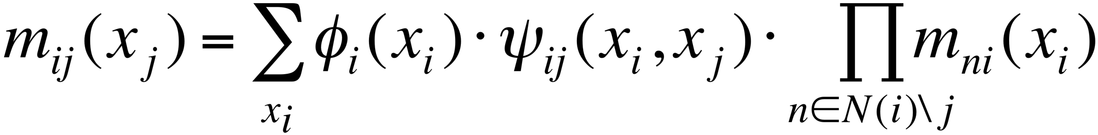
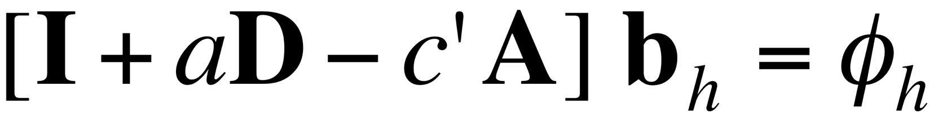
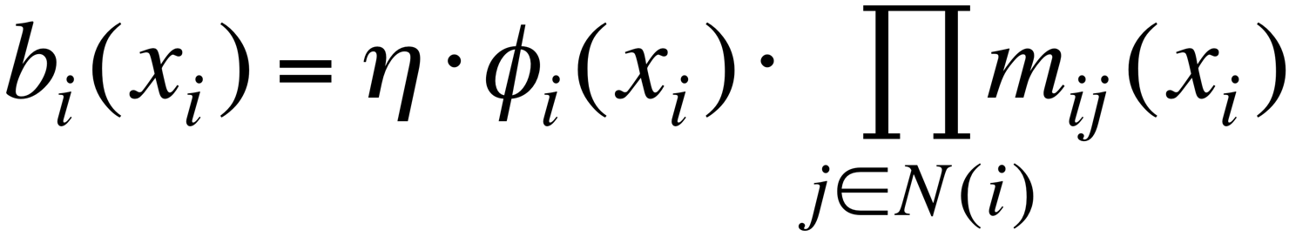
BP vs. Linearized BP
Original [Yedidia+]:
Our proposal:
Belief Propagation
BP is approximated by
Linearized BP
1
1
1
d1
d2
d3
0 1 0
1 0 1
0 1 0
?
0
-10⁻²
10⁻²
non-linear
linear
Notes:
Half: yedidia equations → non-linear equations
Half: theorem -→ linear
Swap!

Slide 76
Generalization: zooBP
FastBP: for uni-partite graph
1 type of nodes (eg., humans)
1 type of edge (eg., ‘friends’)
2 classes (’red’/’green’)
zooBP: for tensor / KB
many types of nodes (humans, products, factories)
many types of edges
many classes per node-type

Slide 77
Problem: e-commerce ratings fraud
Given a heterogeneous graph on users, products, sellers and positive/negative ratings with “seed labels”
Find the top k most fraudulent users, products and sellers

Slide 78
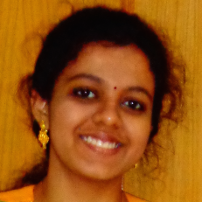
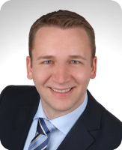
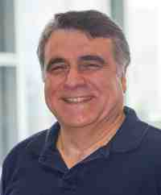
Problem: e-commerce ratings fraud
Given a heterogeneous graph on users, products, sellers and positive/negative ratings with “seed labels”
Find the top k most fraudulent users, products and sellers
Dhivya Eswaran, Stephan Günnemann, Christos Faloutsos, “ZooBP: Belief Propagation for Heterogeneous Networks”, VLDB 2017

Slide 79

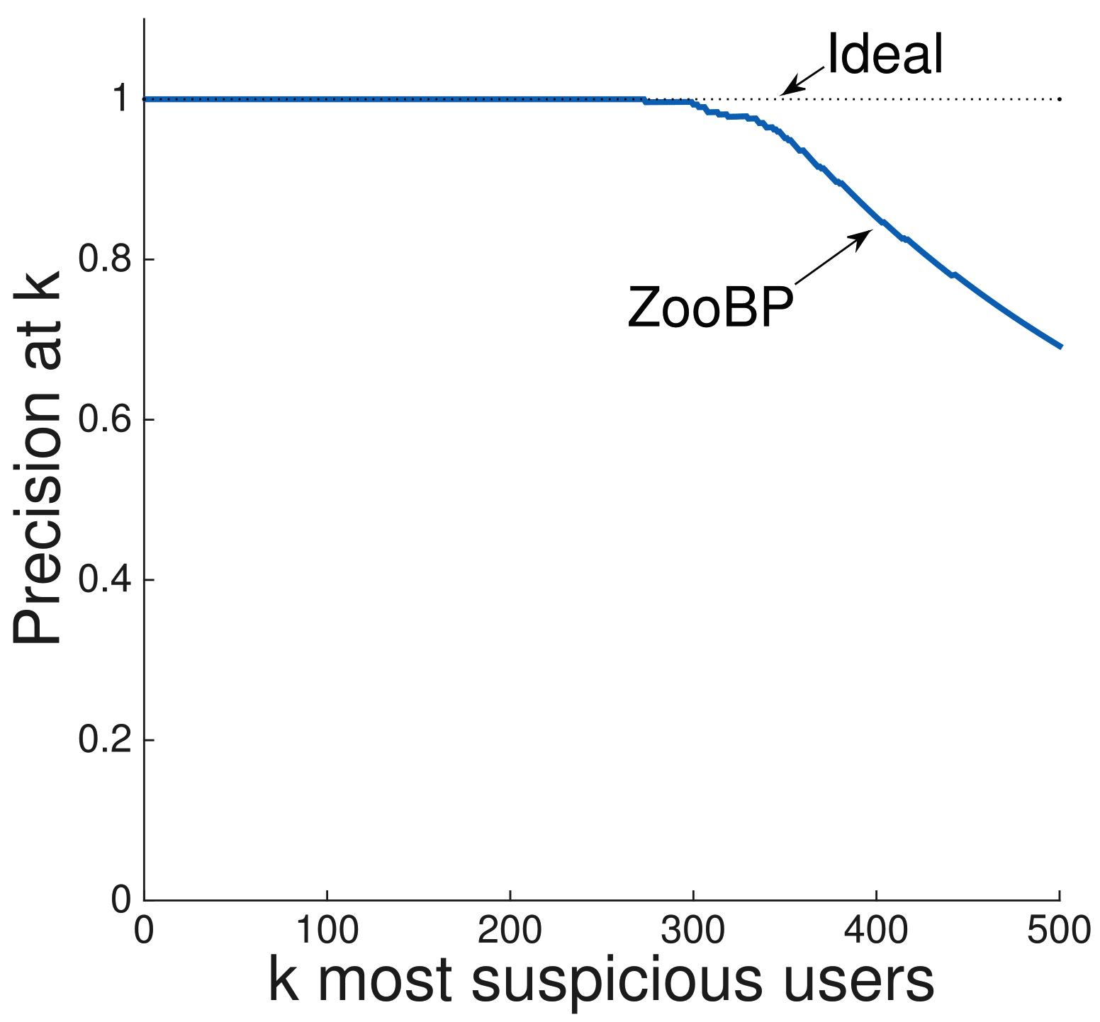
ZooBP in the real world
Near 100% precision on top 300 users (Flipkart)
Flagged users: suspicious
400 ratings in 1 sec
5000 good ratings and no bad ratings
Dhivya Eswaran, Stephan Günnemann, Christos Faloutsos, “ZooBP: Belief Propagation for Heterogeneous Networks”, VLDB 2017

Slide 80
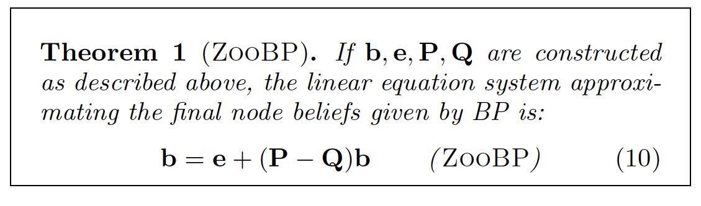
Problem: e-commerce ratings fraud
Dhivya Eswaran, Stephan Günnemann, Christos Faloutsos, “ZooBP: Belief Propagation for Heterogeneous Networks”, VLDB 2017

Slide 81


ZooBP: features
Fast; convergence guarantees.
600x (matlab)
3x (C++)
ideal
Near-perfect accuracy
linear in graph size
Dhivya Eswaran, Stephan Günnemann, Christos Faloutsos, “ZooBP: Belief Propagation for Heterogeneous Networks”, VLDB 2017

Slide 82
ZooBP: code etc
http://www.cs.cmu.edu/~deswaran/code/zoobp.zip
Dhivya Eswaran, Stephan Günnemann, Christos Faloutsos, “ZooBP: Belief Propagation for Heterogeneous Networks”, VLDB 2017

Slide 83
Roadmap
Motivation
Why study graphs for amazon?
Part#1: Static graphs - unsupervised
Part#2: Static graphs – semi-supervised
Motivation: e-bay fraud [Chau+]
BP: Basics
Linearized BP [Koutra +]
Applications
…

Slide 84


Network Effect Tools: SNARE
OPTIONAL
Some accounts are sort-of-suspicious – how to combine weak signals?
Before
Mary McGlohon, Stephen Bay, Markus G. Anderle, David M. Steier, Christos Faloutsos: SNARE: a link analytic system for graph labeling and risk detection. KDD 2009: 1265-1274

Slide 85






Polonium: Tera-Scale Graph Mining and Inference for Malware Detection
OPTIONAL
PATENT PENDING
SDM 2011, Mesa, Arizona
Polo Chau
Machine Learning Dept
Carey Nachenberg
Vice President & Fellow
Jeffrey Wilhelm
Principal Software Engineer
Adam Wright
Software Engineer
Prof. Christos Faloutsos
Computer Science Dept

Slide 86


Polonium: The Data
OPTIONAL
√
60+ terabytes of data anonymously contributed by participants of worldwide Norton Community Watch program
50+ million machines
900+ million executable files
Constructed a machine-file bipartite graph (0.2 TB+)
1 billion nodes (machines and files)
37 billion edges
√
√
Notes:
As of today, has grown to more than three times

Slide 87
P2: static – semi-sup: Recipes
R2: BP, and zooBP
www.cs.cmu.edu/~deswaran/code/zoobp.zip
128.2.2.3

Slide 88
Roadmap
Motivation
Why study graphs for amazon?
Part#1: Static graphs - unsupervised
Part#2: Static graphs – semi-supervised
Part#3: time-evolving graphs; tensors
Conclusions

Slide 89
Part 3:
Time evolving
graphs; tensors

Slide 90

P3: time-evolving: Recipes
R3.1) Tensors
3am, 4/1
=
128.2.2.3
3am, 4/1
R3.2) IAT (inter-arrival times)
10pm, 4/3

Slide 91
Graphs over time -> tensors!
Problem #3.1:
Given who calls whom, and when
Find patterns / anomalies
johnson
smith

Slide 92
Graphs over time -> tensors!
Problem #3.1:
Given who calls whom, and when
Find patterns / anomalies

Slide 93
Graphs over time -> tensors!
Problem #3.1:
Given who calls whom, and when
Find patterns / anomalies
Tue
Mon

Slide 94
Graphs over time -> tensors!
Problem #3.1:
Given who calls whom, and when
Find patterns / anomalies
time
caller
callee

Slide 95
Graphs over time -> tensors!
Problem #3.1’’:
Given subject – verb – object facts
Find patterns / anomalies
verb
MANY more settings,
with >2 ‘modes’
subject
object

Slide 96
Graphs over time -> tensors!
Problem #3.1’’’:
Given <triplets>
Find patterns / anomalies
mode3
MANY more settings,
with >2 ‘modes’
(and 4, 5, etc modes)
mode1
mode2

Slide 97
Reminder: intro to SVD
Recall: (SVD) matrix factorization: finds blocks
‘music lovers’
‘singers’
‘sports lovers’
‘athletes’
‘citizens’
‘politicians’
M
idols
N
fans
+
+
~

Slide 98
Answer: tensor factorization
PARAFAC decomposition
colluders
Apple
fans
jewelry
timestamp
customer
+
+
=
product

Slide 99
Answer: tensor factorization
PARAFAC decomposition
Results for who-calls-whom-when
4M x 15 days
??
??
??
time
caller
+
+
=
callee

Slide 100



Anomaly detection in time-evolving graphs
=
Anomalous communities in phone call data:
European country, 4M clients, data over 2 weeks
~200 calls to EACH receiver on EACH day!
1 caller
5 receivers
4 days of activity

Slide 101
Anomaly detection in time-evolving graphs
=
Anomalous communities in phone call data:
European country, 4M clients, data over 2 weeks
~200 calls to EACH receiver on EACH day!
1 caller
5 receivers
4 days of activity

Slide 102

Anomaly detection in time-evolving graphs
=
Anomalous communities in phone call data:
European country, 4M clients, data over 2 weeks
~200 calls to EACH receiver on EACH day!
1 caller
5 receivers
4 days of activity

Slide 103


Anomaly detection in time-evolving graphs
=
Anomalous communities in phone call data:
European country, 4M clients, data over 2 weeks
~200 calls to EACH receiver on EACH day!
Miguel Araujo, Spiros Papadimitriou, Stephan Günnemann, Christos Faloutsos, Prithwish Basu, Ananthram Swami,
Evangelos Papalexakis, Danai Koutra. Com2: Fast Automatic Discovery of Temporal (Comet) Communities. PAKDD 2014, Tainan, Taiwan.

Slide 104
Roadmap
Motivation
Why study graphs for amazon?
Part#1: Static graphs - unsupervised
Part#2: Static graphs – semi-supervised
Part#3: time-evolving graphs; tensors
P3.1: tools/tensors
P3.2: other patterns – inter-arrival time
Conclusions

Slide 105




RSC: Mining and Modeling Temporal Activity in Social Media
Universidade
de São Paulo
KDD 2015 – Sydney, Australia
Alceu F. Costa* Yuto Yamaguchi Agma J. M. Traina
Caetano Traina Jr. Christos Faloutsos
*alceufc@icmc.usp.br

Slide 106

Pattern Mining: Datasets
Reddit Dataset Time-stamp from comments 21,198 users 20 Million time-stamps | Twitter Dataset Time-stamp from tweets 6,790 users 16 Million time-stamps
For each user we have:
Sequence of postings time-stamps: T = (t₁, t₂, t₃, …)
Inter-arrival times (IAT) of postings: (∆₁, ∆₂, ∆₃, …)
∆₁
∆₂
∆₃
time
t₁
t₂
t₃
t₄
Notes:
In this work we analyzed data from two services: reddit and twitter
For the reddit dataset we have time-stamp sequences from over 20k users and
For the twitter dataset we have time-stamp sequences from over 6k users
For each user had at least a sequence of at least 900 time-stamps.
For the twitter dataset the time-stamps were from tweets.
For the reddit dataset the time-stamps were from user comments.
From each sequence of time-stamps we also computed the IAT (inter-arrival time) between postings

Slide 107

Human? Robots?
linear
log

Slide 108
Human? Robots?
2’
3h
1day
linear
log

Slide 109

IAT heatmaps
Twitter
x
y

Slide 110
IAT heatmaps

Slide 111
Experiments: Can RSC-Spotter Detect Bots?
Precision vs. Sensitivity Curves
Good performance: curve close to the top
Twitter
Precision > 94%
Sensitivity > 70%
With strongly imbalanced datasets
# humans >> # bots

Slide 112
Experiments: Can RSC-Spotter Detect Bots?
Precision vs. Sensitivity Curves
Good performance: curve close to the top
Reddit
Precision > 96%
Sensitivity > 47%
With strongly imbalanced datasets
# humans >> # bots

Slide 113
P3: time-evolving: Recipes
R3.1) Tensors
3am, 4/1
=
128.2.2.3
3am, 4/1
R3.2) IAT (inter-arrival times)
10pm, 4/3

Slide 114











Cast
Akoglu,
Leman
Araujo,
Miguel
Beutel,
Alex
Chau,
Polo
Eswaran,
Dhivya
Hooi,
Bryan
Kang, U
Koutra,
Danai
Papalexakis,
Vagelis
Shah,
Neil
Shin,
Kijung
Song,
Hyun Ah

Slide 115

References - reminder
D. Chakrabarti, C. Faloutsos: Graph Mining – Laws, Tools and Case Studies, Morgan Claypool 2012

Slide 116
Reminder: PERSEUS-HUB
http://perseushub.com
http://www.mdpi.com/2227-9709/4/3/22/pdf
Jin +, PERSEUS-HUB: Interactive and Collective Exploration of Large-Scale Graphs, Informatics 2017

Slide 117
Additional References – P1
Bryan Hooi, Hyun Ah Song, Alex Beutel, Neil Shah, Kijung Shin, Christos Faloutsos. FRAUDAR: Bounding Graph Fraud in the Face of Camouflage. KDD 2016 (best paper award)
Kijung Shin, Bryan Hooi, and Christos Faloutsos, M-Zoom: Fast Dense-Block Detection in Tensors with Quality Guarantees, PKDD 2016.
Both find dense blocks = lockstep behavior
Meng Jiang, Alex Beutel, Peng Cui, Bryan Hooi, Shiqiang Yang, and Christos Faloutsos. A General Suspiciousness Metric for Dense Blocks in Multimodal Data, ICDM 2015.
Thus, we can examine most-suspicious-block first

Slide 118
Additional References – P3
Nicholas Sidiropoulos, Lieven De Lathauwer, Xiao Fu, Kejun Huang, Evangelos E. Papalexakis, Christos Faloutsos, Tensor decomposition for signal processing and machine learning, IEEE Transactions on Signal Processing, 2017.
Survey on tensors, with ML applications

Slide 119
P1: static – un-sup: Recipes
R1.1) Power law
violations
128.2.2.3
R1.2) eigenPlots

Slide 120
P2: static – semi-sup: Recipes
R2: BP, and zooBP
www.cs.cmu.edu/~deswaran/code/zoobp.zip
128.2.2.3

Slide 121
P3: time-evolving: Recipes
R3.1) Tensors
3am, 4/1
=
128.2.2.3
3am, 4/1
R3.2) IAT (inter-arrival times)
10pm, 4/3

Slide 122
Not stressed enough:
Visualization

Slide 123

THANK YOU
christos@cs.cmu.edu
Visualization

